Slide 1


Binary Search Trees
Dictionary Operations:
  get(key)
  put(key, value)
  remove(key)
Additional operations:
  ascend()
  get(index) (indexed binary search tree)
  remove(index) (indexed binary search tree)

Slide 2
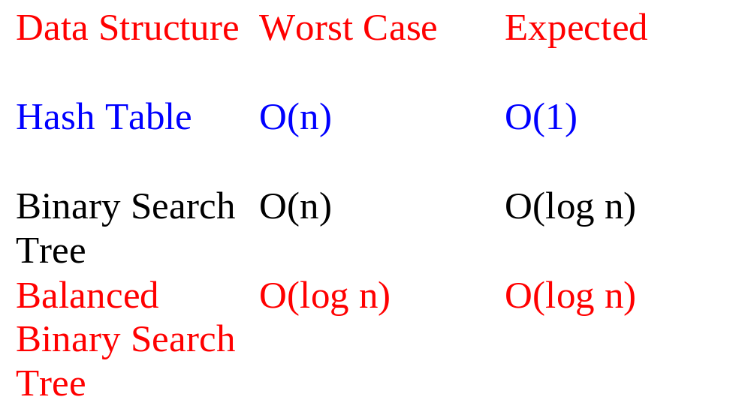
Complexity Of Dictionary Operations get(), put() and remove()
n is number of elements in dictionary

Slide 3
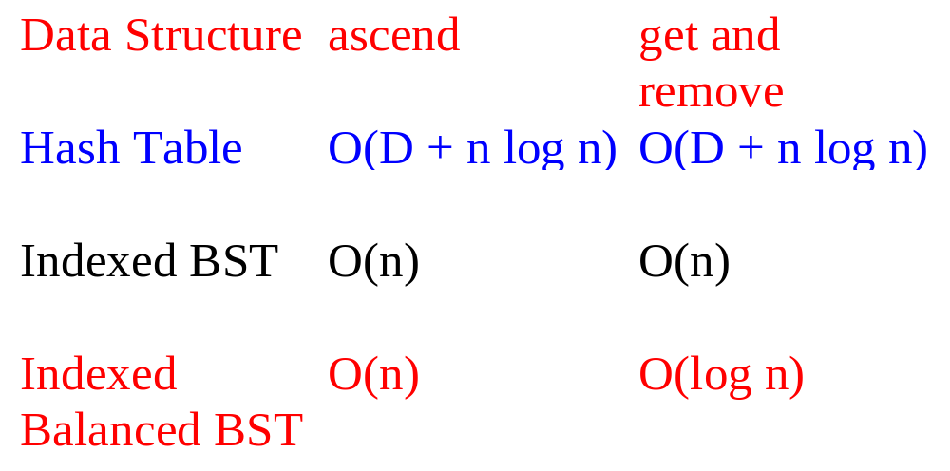
Complexity Of Other Operations ascend(), get(index), remove(index)
D is number of buckets

Slide 4
Definition Of Binary Search Tree
A binary tree.
Each node has a (key, value) pair.
For every node x, all keys in the left subtree of x are smaller than that in x.
For every node x, all keys in the right subtree of x are greater than that in x.

Slide 5
Example Binary Search Tree
20
10
40
6
15
30
2
8
25
Only keys are shown.

Slide 6
The Operation ascend()
20
10
40
6
15
30
2
8
25
Do an inorder traversal. O(n) time.

Slide 7
The Operation get()
20
10
40
6
15
30
2
8
25
Complexity is O(height) = O(n), where n is number of nodes/elements.

Slide 8
The Operation put()
20
10
40
6
15
30
2
8
25
35
Put a pair whose key is 35.

Slide 9
The Operation put()
20
10
40
6
15
30
2
8
25
35
7
Put a pair whose key is 7.

Slide 10
The Operation put()
20
10
40
6
15
30
18
25
35
2
8
7
Put a pair whose key is 18.

Slide 11
The Operation put()
20
10
40
6
15
30
18
25
35
2
8
7
Complexity of put() is O(height).

Slide 12
The Operation remove()
Three cases:
  Element is in a leaf.
  Element is in a degree 1 node.
  Element is in a degree 2 node.

Slide 13
Remove From A Leaf
20
10
40
6
15
30
18
25
35
2
8
7
Remove a leaf element. key = 7

Slide 14
Remove From A Leaf (contd.)
20
10
40
6
15
30
18
25
35
2
8
7
Remove a leaf element. key = 35

Slide 15
Remove From A Degree 1 Node
20
10
40
6
15
30
18
25
35
2
8
7
Remove from a degree 1 node. key = 40

Slide 16
Remove From A Degree 1 Node (contd.)
20
10
40
6
15
30
18
25
35
2
8
7
Remove from a degree 1 node. key = 15

Slide 17
Remove From A Degree 2 Node
20
10
40
6
15
30
18
25
35
2
8
7
Remove from a degree 2 node. key = 10

Slide 18
Remove From A Degree 2 Node
20
10
40
6
15
30
18
25
35
2
8
7
Replace with largest key in left subtree (or smallest in right subtree).

Slide 19
Remove From A Degree 2 Node
20
10
40
6
15
30
18
25
35
2
8
7
Replace with largest key in left subtree (or smallest in right subtree).

Slide 20
Remove From A Degree 2 Node
20
8
40
6
15
30
18
25
35
2
8
7
Replace with largest key in left subtree (or smallest in right subtree).

Slide 21
Remove From A Degree 2 Node
20
8
40
6
15
30
18
25
35
2
8
7
Largest key must be in a leaf or degree 1 node.

Slide 22
Another Remove From A Degree 2 Node
20
10
40
6
15
30
18
25
35
2
8
7
Remove from a degree 2 node. key = 20

Slide 23
Remove From A Degree 2 Node
20
10
40
6
15
30
18
25
35
2
8
7
Replace with largest in left subtree.

Slide 24
Remove From A Degree 2 Node
20
10
40
6
15
30
18
25
35
2
8
7
Replace with largest in left subtree.

Slide 25
Remove From A Degree 2 Node
18
10
40
6
15
30
18
25
35
2
8
7
Replace with largest in left subtree.

Slide 26
Remove From A Degree 2 Node
18
10
40
6
15
30
2
8
25
35
7
Complexity is O(height).

Slide 27
Indexed Binary Search Tree
Binary search tree.
Each node has an additional field.
  leftSize = number of nodes in its left subtree

Slide 28
Example Indexed Binary Search Tree
7
20
4
3
10
40
1
0
1
6
15
30
0
0
0
1
0
18
25
35
2
8
0
7
leftSize values are in red

Slide 29
leftSize And Rank
Rank of an element is its position in inorder (inorder = ascending key order).
[2,6,7,8,10,15,18,20,25,30,35,40]
rank(2) = 0
rank(15) = 5
rank(20) = 7
leftSize(x) = rank(x) with respect to elements in subtree rooted at x

Slide 30
leftSize And Rank
7
20
4
3
10
40
1
0
1
6
15
30
0
0
0
1
0
18
25
35
2
8
0
7
sorted list = [2,6,7,8,10,15,18,20,25,30,35,40]

Slide 31
get(index) And remove(index)
7
20
4
3
10
40
1
0
1
6
15
30
0
0
0
1
0
18
25
35
2
8
0
7
sorted list = [2,6,7,8,10,15,18,20,25,30,35,40]

Slide 32
get(index) And remove(index)
if index = x.leftSize desired element is x.element
if index < x.leftSize desired element is index’th element in left subtree of x
if index > x.leftSize desired element is (index - x.leftSize-1)’th element in right subtree of x

Slide 33
Applications
(Complexities Are For Balanced Trees)
Best-fit bin packing in O(n log n) time.
Representing a linear list so that get(index), add(index, element), and remove(index) run in O(log(list size)) time (uses an indexed binary tree, not indexed binary search tree).
Can’t use hash tables for either of these applications.

Slide 34
Linear List As Indexed Binary Tree
7
h
4
3
e
l
1
0
1
b
f
j
0
0
0
1
0
g
i
k
a
d
0
c
list = [a,b,c,d,e,f,g,h,i,j,k,l]
Notes:
List elements are placed in a binary tree so that an inorder traversal of the binary tree visits the elements in list order from left to right.
get() and remove() work as they do in an indexed binary search tree.

Slide 35
add(5,’m’)
7
h
4
3
e
l
1
0
1
b
f
j
0
0
0
1
0
g
i
k
a
d
0
c
list = [a,b,c,d,e,f,g,h,i,j,k,l]

Slide 36
add(5,’m’)
7
h
4
3
e
l
1
0
1
b
f
j
0
0
0
1
0
g
i
k
a
d
0
c
list = [a,b,c,d,e, m,f,g,h,i,j,k,l]
find node with element 4 (e)

Slide 37
add(5,’m’)
7
h
4
3
e
l
1
0
1
b
f
j
0
0
0
1
0
g
i
k
a
d
0
c
list = [a,b,c,d,e, m,f,g,h,i,j,k,l]
find node with element 4 (e)

Slide 38
add(5,’m’)
7
h
4
3
e
l
1
m
0
1
b
f
j
0
0
0
1
0
g
i
k
a
d
0
c
add m as right child of e; former right subtree of e becomes right subtree of m

Slide 39
add(5,’m’)
7
h
4
3
e
l
1
0
1
b
f
j
0
0
0
1
0
m
g
i
k
a
d
0
c
add m as leftmost node in right subtree of e

Slide 40
add(5,’m’)
Other possibilities exist.
Must update some leftSize values on path from root to new node.
Complexity is O(height).

